Slide 1
Advanced Python Programming
Webapp, Django and Object Relational Mapping (ORM)
Marco Prenassi
Laboratory of Data Engineering, Area Science Park
date

Slide 2
CREATING A WEBAPP USING DJANGO
1) go to your venv (source …) and install django
> pip install django
2) create a folder that will contain your website (e.g., django_tutorial_site)
> mkdir –p django_tutorial_site
> cd Django_tutorial_site
3) create the Django site and the first webapp
> django-admin startproject django_tutorial_site .
> python3 manage.py startapp django_tutorial_app

Slide 3
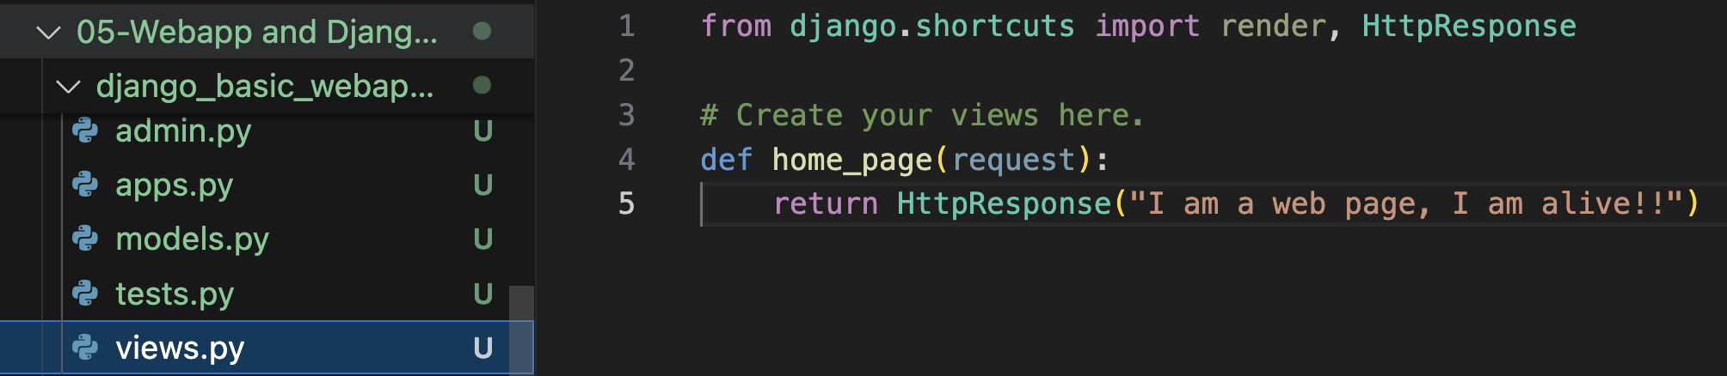
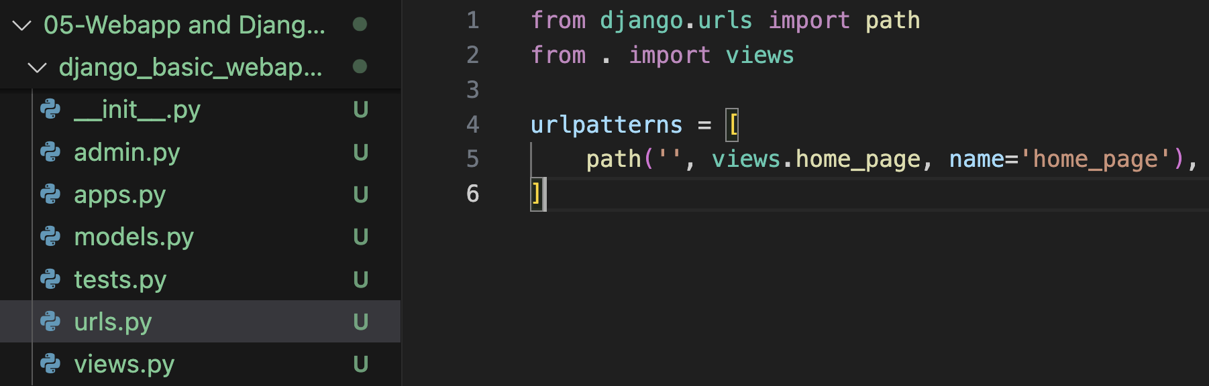
CREATING A WEBAPP USING DJANGO
1) edit views.py inside the
app folder
2) create a urls.py inside the app folder, and reference the single pages/views

Slide 4
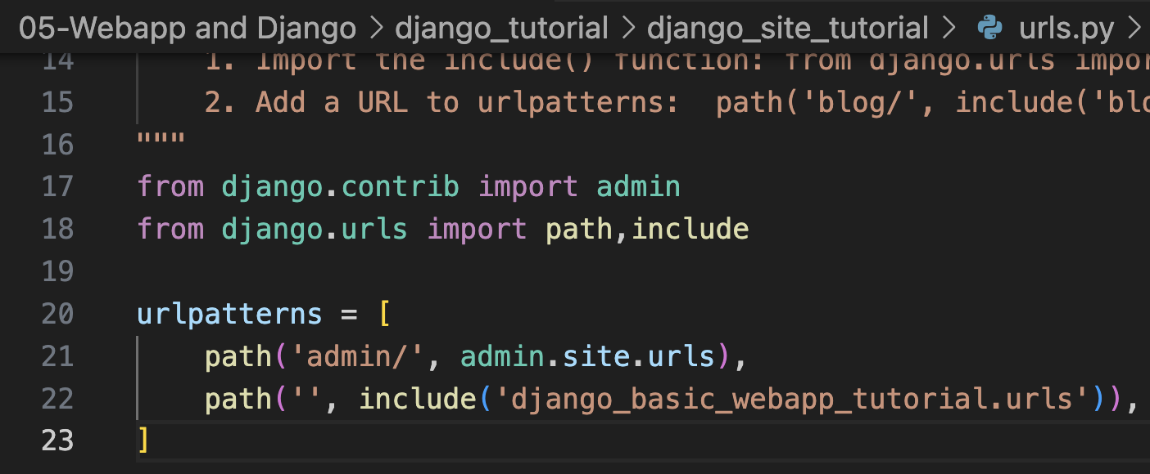
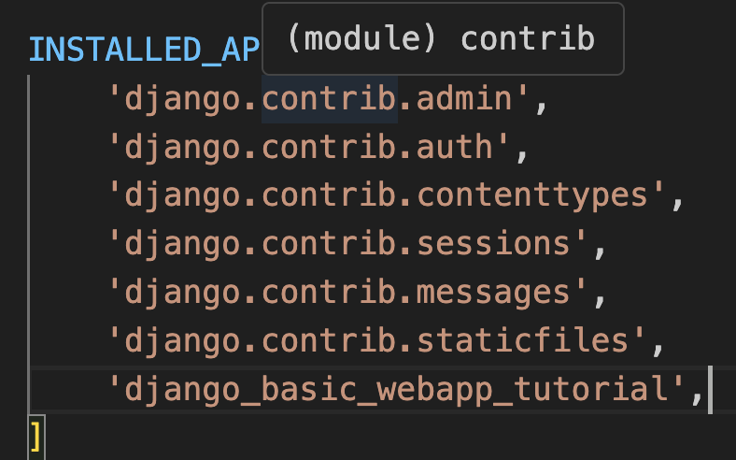
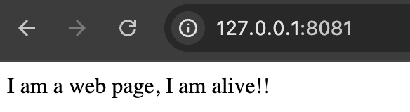
CREATING A WEBAPP USING DJANGO
3) edit the urls.py inside the SITE folder, and reference the webapp
4) inform the SITE about your webapp writing the name of the app in settings.py
5) run the server:
> python3 manage.py runserver 8081

Slide 5


OBJECT RELATIONAL MAPPING
Encapsulation
Abstraction
Inheritance
Polymorphism
OBJECT ORIENTED PROGRAMMING
WHY IS IT USED SO MUCH?
OBJECT-ORIENTED PARADIGM
CLASS
OOP
OBJECT

Slide 6
OBJECT ORIENTED PROGRAMMING AND STRUCTURED QUERY LANGUAGE
OBJECT-ORIENTED PARADIGM
CLASS
OOP
OBJECT
SCHEMA
SQL
INSTANCE
RELATIONAL DB
EVERYTHING ELSE (PRETTY MUCH) IS DIFFERENT
ALTHOUGHT THEY BOTH COULD STORE DATA (Object Oriented DBMS)

Slide 7
OBJECT ORIENTED PROGRAMMING AND STRUCTURED QUERY LANGUAGE
OBJECT-ORIENTED PARADIGM
CLASS
OOP
OBJECT
SCHEMA
SQL
INSTANCE
RELATIONAL DB
EVERYTHING ELSE (PRETTY MUCH) IS DIFFERENT
ALTHOUGHT THEY BOTH COULD STORE DATA (Object Oriented DBMS)

Slide 8
OBJECT RELATIONAL MAPPING
Advantages:
Speeds-up Development - eliminates the need for repetitive SQL code. <- Yes
Reduces Development Time. <- In medium to large projects
Reduces Development Costs. <- In medium to large project
Overcomes vendor specific SQL differences - the ORM knows how to write vendor specific SQL so you don't have to.
Could be (albeit it depends on the implementation) more security compliant
AND, OF COURSE, WITH ORM WE EXPLOIT THE BEST ASPECTS OF BOTH WORLDS
from: https://stackoverflow.com/questions/4667906/the-advantages-and-disadvantages-of-using-orm

Slide 9
OBJECT RELATIONAL MAPPING
Disadvantages:
Loss in developer productivity whilst they learn to program with ORM.
Developers lose understanding of what the code is actually doing - the developer is more in control using SQL. <- Not always true, but is a pitfall
ORM has a tendency to be slow. <- it is still a layer
ORM fail to compete against SQL queries for complex queries. <– Not always true
from: https://stackoverflow.com/questions/4667906/the-advantages-and-disadvantages-of-using-orm

Slide 10

SQLALCHEMY
SQLAlchemy offers tools for database schema generation, querying, and object-relational mapping.
Key features include:
A comprehensive embedded domain-specific language for SQL in Python called "SQLAlchemy Core" that provides means to construct and execute SQL queries.
A powerful ORM that allows the mapping of Python classes to database tables.
Support for database schema migrations.
Compatibility with multiple database backends.
Tools for database connection pooling and transaction management.
https://en.wikipedia.org/wiki/SQLAlchemy

Slide 11
DJANGO ORM
1a) Create the models in app_name/models.py
from django.db import models
class ImageMetadata(models.Model):
path = models.CharField(max_length=256)
height = models.PositiveIntegerField()
width = models.PositiveIntegerField()
def __str__(self):
return self.path
class InstrumentMetadata(models.Model):
device_id = models.CharField(primary_key=True)
device_name = models.CharField(max_length=42)
def __str__(self):
return self.device_name
1b) Make & apply migrations (in the terminal)
> python manage.py makemigrations
> python manage.py migrate
YOU ARE CREATING THE DATABASE SCHEMA!

Slide 12
DJANGO ORM
2) Let’s use the Django Shell
YOU ”LINKING” THE OBJECTS TO THE DATABASE
> python manage.py shell
3) Import the models and insert data into the models
>> from django_orm_tutorial.models import ImageMetadata, InstrumentMetadata
>> image_metadata1 = ImageMetadata.objects.create(path="/data/imgs/a.tif", height=1024, width=2048)
>> image_metadata2 = ImageMetadata.objects.create(path="/data/imgs/b.tif", height=800, width=600)
>> instrument_metadata1 = InstrumentMetadata.objects.create(device_id=”A0018", device_name=”Novaseq6000")
>> instrument_metadata2 = InstrumentMetadata.objects.create(device_id=”ONT-42", device_name=”Nanopore")
YOU ARE PUTTING DATA INSIDE THE DATABASE!

Slide 13
DJANGO ORM
4a) Query the models – obtain all the entries
>> ImageMetadata.objects.all()
>> InstrumentMetadata.objects.all()
>> for image_metadata in ImageMetadata.objects.all(): # e.g., get the paths
print(image_metadata)
4b) Query the models - filter a subset of the queries
Images wider than 1000 px
>> ImageMetadata.objects.filter(width__gt=1000)
Instruments whose name contains "micro" (case-insensitive)
>> InstrumentMetadata.objects.filter(device_name__icontains="micro")
4b) Query the models – get a single OBJECT
ImageMetadata.objects.get(path="/data/imgs/a.tif")
InstrumentMetadata.objects.get(pk="A0018") # primary key shortcut, pk is unique by definition!

Slide 14
DJANGO ORM
5) UPDATE THE DATA
instrument_metadata = InstrumentMetadata.objects.get(pk=”ONT-42")
instrument.device_name = ”iScan"
instrument.save()
6) DELETE THE DATA
instrument_metadata = InstrumentMetadata.objects.get(pk=”ONT-42")
instrument_metadata.delete()
7+) A LOT MORE POSSIBILITIES
instrument_metadata, created: bool = InstrumentMetadata.objects.get_or_create(..)
instrument_metadata, created: bool = InstrumentMetadata.objects.update_or_create(..)
number: int = InstrumentMetadata.objects.count()
exist: bool = InstrumentMetadata.objects. filter(device_id=”ABC-1").exists()
and bulk create, bulk update etc…

Slide 15
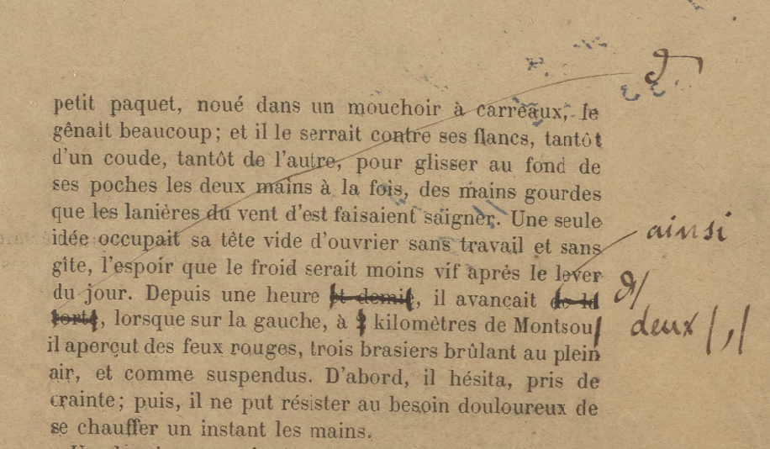
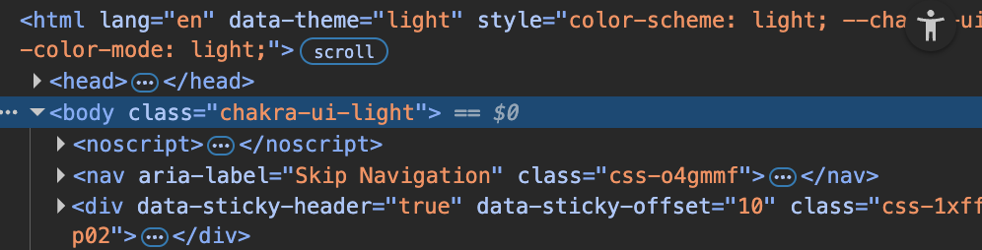
HTML and TEMPLATES
HTML (HyperText Markup Language) defines the structure of a web page.
Static: the same content is shown to every user.
Django Templates (Dynamic HTML)
Extend plain HTML with template language for dynamic content.
Use variables, tags, and filters inside {{ }} and {% %}.
Rendered by Django’s Template Engine.
<h1>Hello, {{ user.name }}!</h1>
<p>Today is {% now "l, d F Y" %}</p>
<ul>
{% for item in items %}
<li>{{ item }}</li>
{% endfor %}
</ul>
Henry W. and Albert A. Berg Collection of English and American Literature, The New York Public Library. "Galley proofs for the novel Germinal, with the author's manuscript corrections" The New York Public Library Digital Collections. 1884 - 1885. https://digitalcollections.nypl.org/items/0415eae0-fcf1-0138-d2ef-0242ac110003

Slide 16
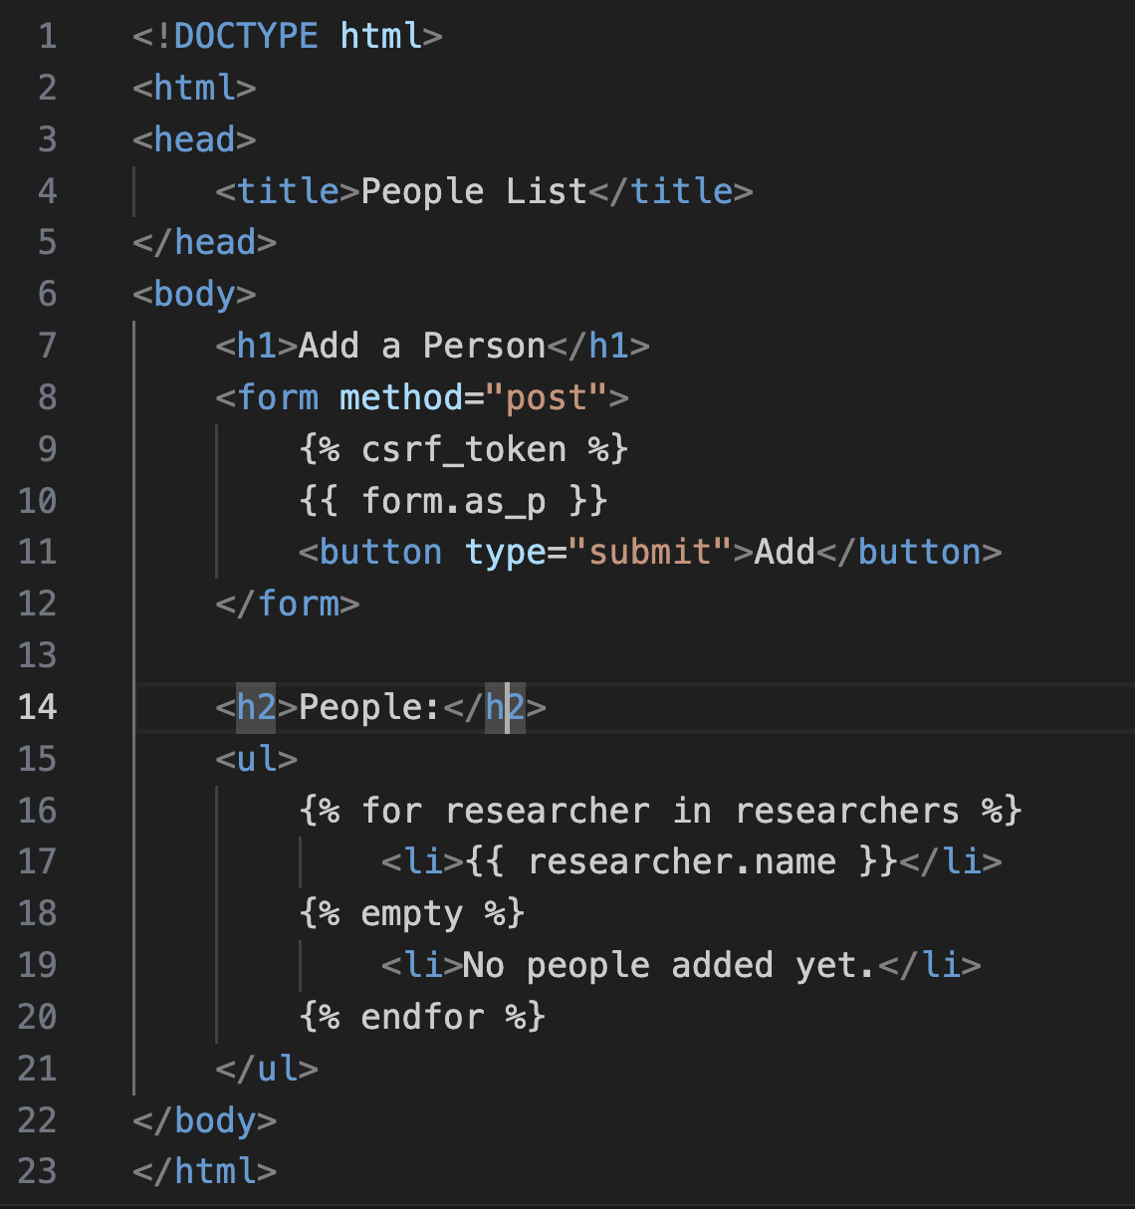
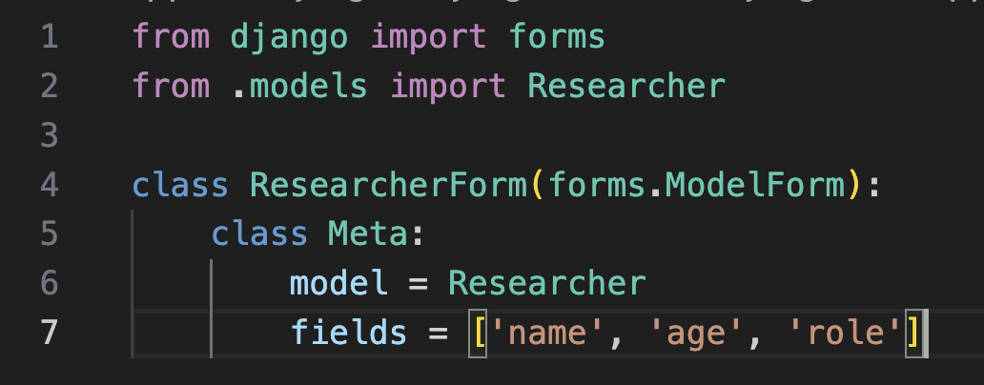
DJANGO FULL APP with FORMS
Let’s use the full capabilities of Django, and remade the first OOP exercise as a WEBAPP.
# Create Researchers (Users)
# Store the Researcher information and visualize it
to do so, let’s introduce the Templates and the Forms
(let’s open visual studio code and follow this from there…)

Slide 17
EXERCISE:
try to integrate the metadata extraction of the previous lesson into Django (easy version, only the metadata):
create a data model to hold the information
import the module and the function needed in views.py
create a view with a form that ask the filename, on method==“POST”, use the filename to read the metadata from the file, then you can
directly render on the same page the metadata
redirect to a new page (a new view) that render the data

Slide 18
Thank you

